Slide 1
Software Quality Assurance

Slide 2
part one
introduction

Slide 3
chapter one
The software quality challenge
1•1 The uniqueness of software
quality assurance
1•2 The environments for which SQA
methods are developed

Slide 4
Differences between software and other industrial product (automobiles,radios,washing machines)
● product complexity
Measured by number of operational modes the product permits, industrial product does not allowed more than a few thousand modes of operation, software can find millions of software operation .
● product visibility
Software are invisible but industrial product are visible. Most of defect in an industrial can detected during the manufacturing process, but defect in software are invisible.
● product development and production process
phases at which detecting defect in industrial product:
1- Product development
designers and SQA staff check and test the product prototype in order to detect defect

Slide 5
Differences between software and other industrial product (automobiles,radios,washing machines) ( cont.)
2- product production planning
Production process and tools are designed and prepared, production line may be need to be designed and built.
3- manufacturing
QA procedures are applied to detect defect of products themselves, this can be corrected by change in design or materials or production tools to eliminate defect.
phases at which detecting defect in software product:
1- Product development
detect inherent product defects, therefore prototype may be reproduction
2- product production planning
This is not required for software product
3- manufacturing
Manufacturing software is limited to copying the product and printing copies of manuals .detect defect are limited at this phase

Slide 6
Factors affecting defect detection in software products vs. other industrial products
characteristic | Software product | Other Industrial product
Complexity | Usually, very complex product allowing for very large number of operational options. | Degree of complexity much lower, allowing at most a few thousand operational options.
Visibility of product | Invisible product, impossible to detect defects or omissions by sight (e.g. of a diskette or CD storing the software) | Visible product, allowing effective detection of defects by sight.
Nature of development and production process | Opportunities to detect defects arise in only one phase, namely product development. | Opportunities to detect defects arise in all phases of development and production: □ product development □ product production planning □ manufacturing

Slide 7
The uniqueness of the software
development process
High complexity
Invisibility of the product
Limited opportunities to detect defects (“bugs”)

Slide 8
Environments for which SQA methods are develop:
● pupils and student as part of their education.
● software amateurs develop software as a hobby.
● professional in engineering, economic, management and develop software to assist them in their work in calculation,research,survey.
● software development professionals (system analyst,
programmers ).

Slide 9
Characteristic of SQA environment process
1• Contractual condition
Contract between software developer and the customer:
- define a list of functional requirement need
- product budget
- project timetable
2• Subjection to customer-supplier relationship
Project team cooperate continuously with the customer, to change any request need
3• Requirement for teamwork
- timetable requirement
- variety of specialization
- benefit from professional

Slide 10
Characteristic of SQA environment process
(cont .)
4• cooperation and coordination with other software teams
cooperation may be required with:
□ other software development teams in the same organization
□ Hardware development teams in the same organization
□ software and hardware development teams of other suppliers
□ customer software and hardware development teams that take part
in the project’s development (see figure 1 )
5• Need for interfaces with other software systems
types of interfaces:-
- input interface
other software transmit data to our software
- output interface
our system transmit data to other.
- input-output interface
(EX. salary processing software package -see figure 2 -)
6• Need to continue carrying out a project when team members change
7• Need to conduct maintenance of the software system for several years

Slide 11
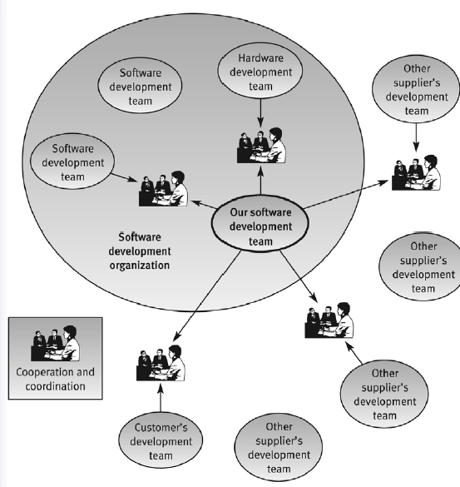
Environment Characteristics
Cooperation &coordination scheme for a software development team
􀂄 Being contracted
􀂄 Subjection to customer
supplier relationship
􀂄 Requirement for teamwork
􀂄 Need for cooperation and
coordination with other
development teams
􀂄 Neioned for interfaces with
other softwardinate systems
􀂄 Need to continue carrying
out a project while the
team changes
􀂄 Need to continue
maintaining the software
system for years

Slide 12
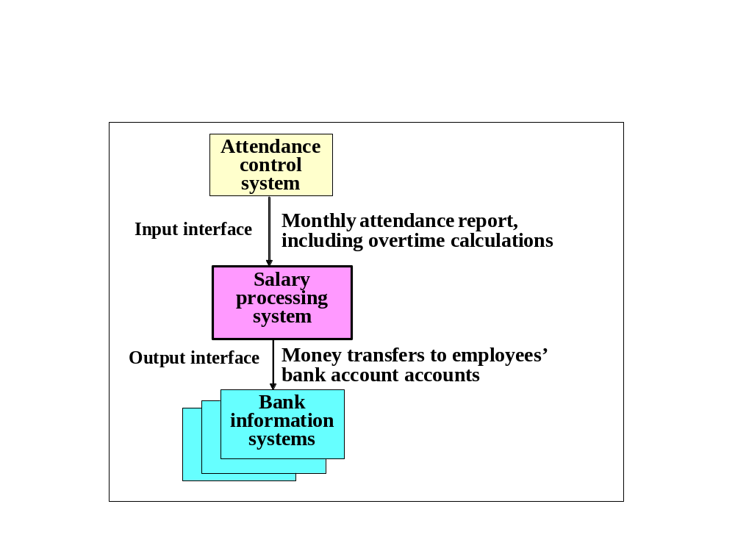
Salary software system - an
example of software interfaces
Figure 2

Slide 13
Chapter Two
What is software quality?

Slide 14
Definitions & Terminology
􀂄 Software
􀂆 Definition & characterization
􀂆 Why do the classical approach to QA not apply?
􀂄 Software quality
􀂆 Definition
􀂆 Quality models
􀂆 Quality attributes
􀂄 Measure quality
􀂆 Reliability, Availability, safety, maintainability,
􀂆 Defect counts
􀂆 Software errors, faults and failures
􀂆 Classification of the causes of software errors

Slide 15
Basic Terminology
Software is:
Computer programs, procedures, and
possibly associated documentation and data pertaining to the operation of a computer system.

Slide 16
Software - IEEE definition
Software is:
□ Computer programs
to activate computer to perform the required application
□ Procedures
define the order and schedule that program are performed
□ Documentation
for development, users (the requirements report, design
reports, program descriptions, etc.)
□ Data pertaining to the operation of a computer system.

Slide 17
What is special about Software?
􀂄 Invisibility of the product
􀂄 Limited opportunities to detect defects
(“bugs”)
􀂄 Often new demanding functionality has
to be realized
􀂄 Often software has to realize extraordinary
high complexity

Slide 18
Classical Quality Assurance (Hardware)
􀂄 Requirements: complete set of external quality
Characteristics → complete set of internal quality
characteristics and a detailed and complete set of
requirements and specifications
􀂄 Design:
􀂆 Design that satisfies the requirements and specifications
􀂆 design for reliability (wear out)
􀂆 design for manufacturability
􀂆 design for maintainability (e.g., self-diagnosis)
􀂄 Manufacturing: statistical production process control
with acceptance sampling
􀂄 Operation: collect failure data for continuous
improvement and predictions (intelligent maintenance)

Slide 19
Software Quality Assurance?
􀂄 Requirements:
􀂆 Completeness is hard to achieve (complexity)
􀂄 Design:
􀂆 design for reliability only in special cases
􀂆 design for manufacturability is not required
􀂆 design for maintainability in special cases
􀂆 Focal area of software quality assurance!
􀂄 Manufacturing → Implementation:
􀂆 limited success with statistical process control (metrics)
􀂄 Operation:
􀂆 Fixing found bugs

Slide 20
What is quality?
􀂄 Quality, simplistically, means that a product should meet
its specification.
􀂄 This is problematical for software systems
􀂆 There is a tension between customer quality
requirements (efficiency, reliability, etc.) and
developer quality requirements (maintainability,
reusability, etc.);
􀂆 Some quality requirements are difficult to specify
in an unambiguous way;
􀂆 Software specifications are usually incomplete and
often inconsistent.

Slide 21
Approaches to Tackle Quality
􀂄 Transcendental view: quality is universally
identifiable, absolute, unique and perfect
􀂄 Product view: the quality of a product is
measurable in an objective manner
􀂄 User view: quality is fitness for use
􀂄 Manufacturing view: quality is the result of the
right development of the product
􀂄 Value-based view (Economic): quality is a
function of costs and benefits

Slide 22
Software Quality – IEEE View
Software quality is:
(1) The degree to which a system, component,
or process meets specified requirements.
(2) The degree to which a system, component,
or process meets customer or user needs
or expectations.

Slide 23
Software Quality
Software quality is Conformance to explicitly stated functional and performance requirements, explicitly documented development standards, and implicit characteristics that are expected of all professionally developed software.
[Pressman2004]

Slide 24
Software Quality
Quality – the degree of excellence of something. We measure the excellence of software via a set of attributes.
(≠ “satisfying requirements”)!
􀂄 Quality is absolute or at least independent of the
requirements underlying the product.
􀂄 It is part of the software development to “get the
right requirements”.
(≠ “user satisfaction”)!
􀂄 McDonald‘s restaurants are popular, but …

Slide 25
Faults, Errors and Failures
􀂄 Error is a defect within the system.
(fault cause)
􀂄 An error is a derivation of the required operation of the
system or subsystem.
(Manifestation of a fault in a system)
􀂄 software faults are a human action which results in
software containing a error
􀂄 A system failure occurs when the system fails to perform
its required function.
(Transition to incorrect service delivery)
􀂄 If the distinction between fault and failure is not critical, defect can
be used as a generic term.

Slide 26
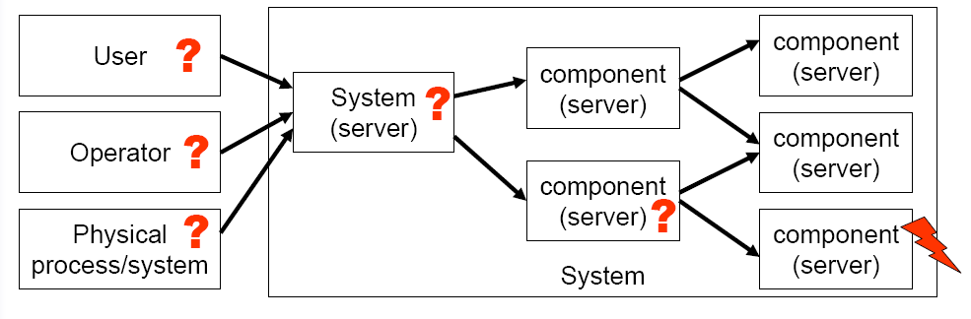
Recursive Nature of Faults
􀂄 A fault in a component can “infect” all other components
which depend on it.
􀂄 Chain of Faults/Failures

Slide 27
Fault/Failure Chain
Error Fault Failure
error→ fault
􀂄 an error is latent when it has not been recognized
􀂄 an error is detected by a detection algorithm/mechanism
fault → failure
􀂄 a fault which has not been activated by the computation
process is dormant
􀂄 a fault is active when it produces an failure
Failure → fault
􀂄 a failure occurs when an error “passes through” and affects the service delivered
􀂄 a failure results in a fault for the system which contains or
interacts with the component

Slide 28
- The root of any software failure is a software error
- Not all software errors become software faults.
- The software error can cause improper functioning.
- Not all software faults end with software failure.
Software development process
Software error
Software fault
software failure

Slide 29
Examples for Fault/Failure Chain
Program error (software):
􀂄 a dormant fault in the written software (instruction or data)
􀂄 upon activation the fault becomes active and produces an error (system
state)
􀂄 if the erroneous data affects the delivered service, a failure occurs
Electromagnetic interference (hardware):
􀂄 leads to faulty input value (either digital or analog)
􀂄 by reading the input the fault becomes active and produces an error
􀂄 if the erroneous input value is processed and becomes visible at the interface
a failure occurs

Slide 30
Examples for Fault/Failure Chain
Program error (software):
􀂄 a dormant fault in the written software (instruction or data)
􀂄 upon activation the fault becomes active and produces an error (system
state)
􀂄 if the erroneous data affects the delivered service, a failure occurs
Electromagnetic interference (hardware):
􀂄 leads to faulty input value (either digital or analog)
􀂄 by reading the input the fault becomes active and produces an error
􀂄 if the erroneous input value is processed and becomesvisible at the interface
a failure occurs

Slide 31
Quality Models
􀂄 Such general definitions of
software quality are not sufficient in practice
􀂄 Thus, software quality is described
by specific quality models
􀂄 causal relationship from
intangible quality views to tangible software measures“
Two main approaches:
􀂄 Standard Models:
􀂆 McCall
􀂆 ISO/IEC 9126
􀂄 Application or company
specific quality models
􀂆 FURPS
􀂆 GQM Approach

Slide 32
Chapter Three
Software quality factors
The need for comprehensive software quality requirements
Classification of requirements into software quality factors
Product operation factors
Product revision factors
Product transition factors
Alternative models of software quality factors
Who is interested in defining quality requirements?
Software compliance with quality factors

Slide 33
The need for comprehensive software quality requirements
There are some characteristic common to all requirement fail:
1- All the software suffered from poor performance in important area such maintenance reliability ,software reuse ,training.
2- The cause for the poor performance of the developed software projects in these areas was the lack of predefined requirement.
3- All the software projects satisfactorily fulfilled the basic requirement for correct calculations

Slide 34
Classification of software requirement into software quality factors
McCall's software quality
factors model
Software quality factors
Product operation factors
Product revision factors
Product transition factors

Slide 35
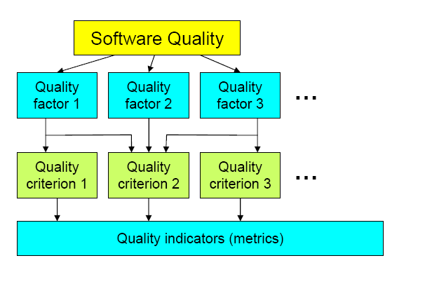
Factor-Criteria-Metrics-Model
Classification into :
􀂄 Factors (to specify): They
describe the external view
of the software, as viewed
by the users.
􀂄 Criteria (to build): They
describe the internal view
of the software, as seen by
the developer.
􀂄 Metrics (to control): They
are defined and used to
provide a scale and
method for measurement.

Slide 36
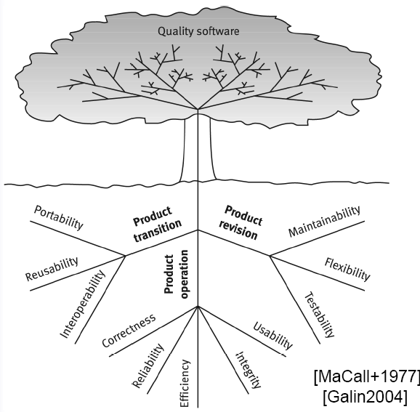
McCall’s Factor Model Tree
􀂄 A quality factor
represents a behavioral
characteristic of the system.
􀂆 Operation
􀂆 Revision
􀂆 Transition
􀂄 A quality criterion is an attribute of a quality factor that is related to
software production and design.
􀂄 A quality metric is a measure that
captures some aspect of a quality
criterion.

Slide 37
Product operation factors
Correctness
Correctness requirement are define in a list of the software system"s required outputs.
Reliability
deal with failures to provide service
Efficiency
deal with the hardware resources needed to perform all the functions of the software system
Integrity
Deal with software system security and requirement to prevent
access to unauthorized persons
Usability
Deal with scope of staff resources needed to train and operate the software system

Slide 38
Product revision factors
Maintainability
Determine the efforts that will be needed by users and
maintenance personnel to identify the reasons for software failure
Flexibility
The capabilities and efforts required to support adaptive maintenance activities
Testability
Deal with the testing of an information system as well as with its operation

Slide 39
Product transition factors
Portability
Tend to the adaptation of a software system to other environments consisting of different hardware and operating system
Reusability
Deal with the use of software modules originally for one project in a new software project currently being developed
Interoperability
Focus on creating interface with other software or with other equipment

Slide 40
Alternative models of software quality factors
Verifiability:
Define design & programming features that enable efficient verification of the design & programming
Expandability:
Refer to future efforts that will be needed to serve larger populations, improve or add new service
Safety:
Eliminate condition hazardous to operators of equipment as a result of errors in process control software.
Manageability:
Refer to the administrative tools that support software modification during the software development & maintenance periods.
Survivability:
Refer to the continuity of service. these define the minimum time allowed between failures of the system,& the maximum time permitted for recovery of service.

Slide 41
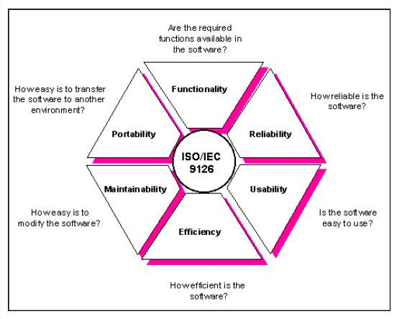
The Six Quality Characteristics of a Software
􀂄 Software quality: The totality of
features and characteristics of a
software product that bear on its
ability to satisfy stated or implied
needs.
􀂄 Software quality characteristic
A set of attributes of a software product by which its quality is described and
evaluated. A software
quality characteristic may be refined
into multiple levels of sub characteristic
􀂄 Each characteristic is refined to a set of sub-characteristics
􀂄 Each sub-characteristic is evaluated
by a set of metrics.
􀂄 Some metrics are common to several sub-characteristics.

Slide 42
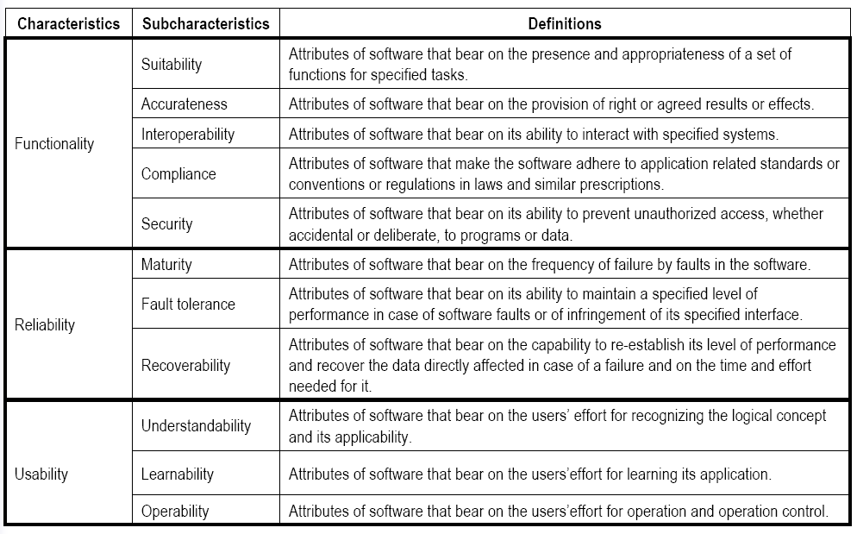

Slide 43
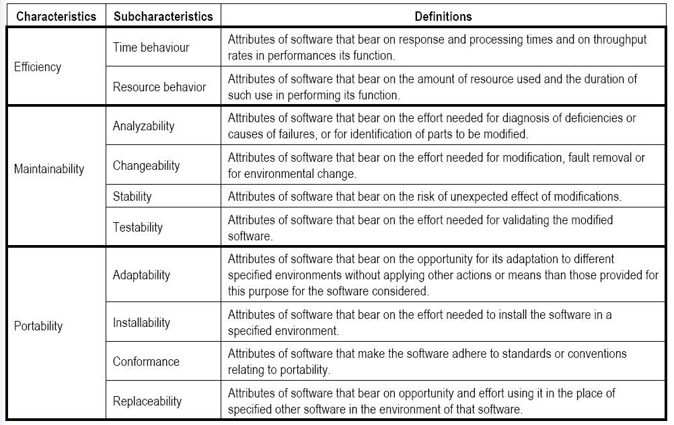

Slide 44
Hewlett Packard: F.U.R.P.S.
􀂄 Result of a statistical project survey at Hewlett Packard 1987
to improve its products:
Factors:
􀂆 Functionality: functions it performs, their generality and
Security
􀂆 Usability: aesthetics, consistency, documentation
􀂆 Reliability: frequency and severity of failure, accuracy of
output
􀂆 Performance: response time, resource consumption
􀂆 Supportability: can it be extended, adapted, corrected?
􀂄 FURPS is originally a company specific quality model

Slide 45
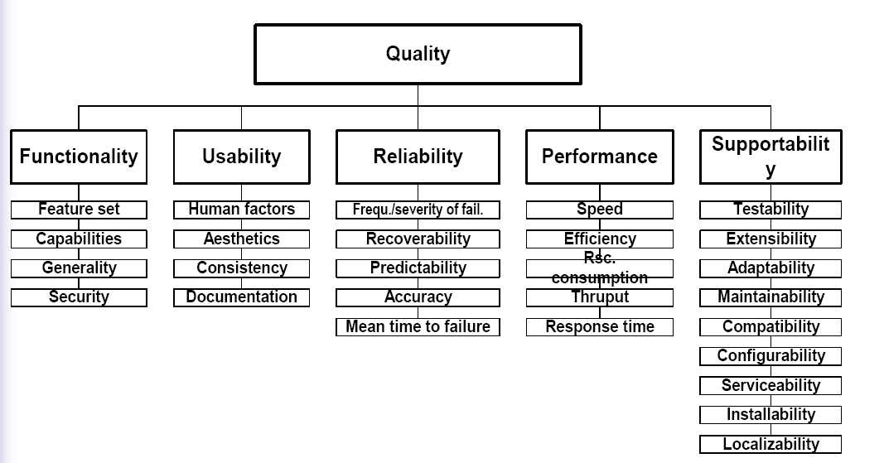
Hewlett Packard: F.U.R.P.S.

Slide 46
GQM: Goal-Question-Metric
􀂄 A measurement program can be more successful
if designed with the goals in mind.
􀂄 GQM approach provides a framework with 3 steps:
1. List the major goals of the development/maintenance
project
2. Derive from each goal the questions that must be
answered to determine if the goals are being met
3. Decide what must be measured to answer the
questions adequately

Slide 47
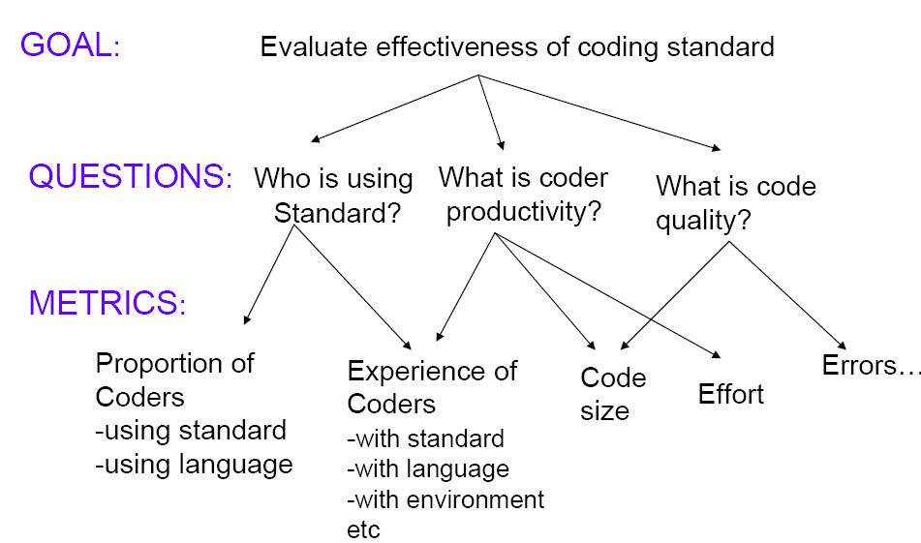
Example

Slide 48
GQM Discussion
􀂄 Benefits :
􀂄 generates only those measures relevant to the goal
􀂄 Several measurements may be needed to answer a single question.
􀂄 A single measurement may apply to more than one question.
􀂄 The goal provides the purpose for collecting the data.
􀂄 Not evident from the GQM
􀂄 The model needed to combine the measurement in a sensible way
so that the question can be answered.
􀂄 It must be supplemented by one or more models that express the
relationship among the metrics. (equation definition is not clear)
􀂄 Disadvantages:
􀂄 Additional efforts to derive the goals and metrics
􀂄 Error prone compared to standard models

Slide 49
Measuring Quality?
􀂄 User‘s view:
􀂆Reliability (number of failures over time)
􀂆 Availability
􀂆 Usability etc.
􀂆Often directly measurable
􀂄 Manufacturer‘s view:
􀂆Defect counts
􀂆Rework costs

Slide 50
Reliability
Reliability is the probability of a component, or system, functioning correctly over a given period time under a given set of operating conditions.
Quantitative:
Reliability R(t) is the probability that the system will conform to its
specification throughout a period of duration t.
􀂄 Note that t is important
􀂄 If a system only needs to operate for ten hours at a time, then that
is the reliability target.

Slide 51
Availability
The availability of a system is the probability that the system will be functioning correctly at any given time.
Quantitative:
Availability A (or V) is the percentage of time for which the
system will conform to its specification.
􀂄 Literally, readiness for service

Slide 52
Safety
􀂄 Safety is a property of a system that it will not endanger
human life or the environment.
􀂄 A safety-related system (safety-critical
system) in one by which the safety of equipment
or plant is assured.

Slide 53
Maintainability
􀂄 Maintenance is the action taken to retain a system
in, or return a system to, its designed operating
conditions. Maintainability is theability of a system
to be maintained (ability to undergo repairs and
modifications).
􀂄 Mean time to repair (MTTR)
Problem: Maintenance induced failures

Slide 54
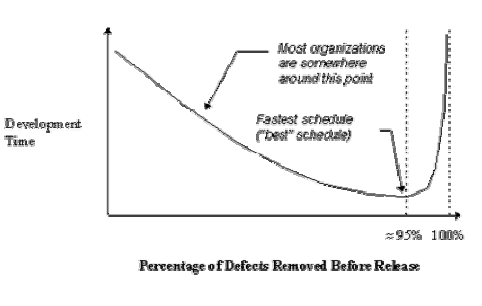
Defect Counts
􀂄 „software errors are the cause of poor software quality“
􀂄 In software, higher quality (in the form of lower defect rates) and
reduced development time go hand in hand.
􀂄 Unlike the low-defect kind of quality, attention to this kind of
quality tends to lengthen the development schedule.
􀂄 Intuitively, the occurrence of defects is negatively related to functionality and reliability.
Defects also interfere, to some degree, with other dimensions of quality.

Slide 55
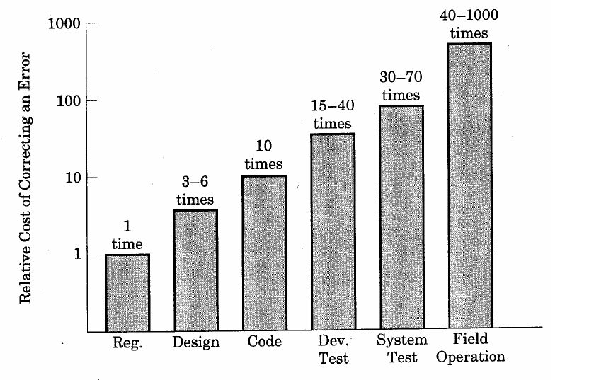

Relative Cost of Correcting Defects

Slide 56
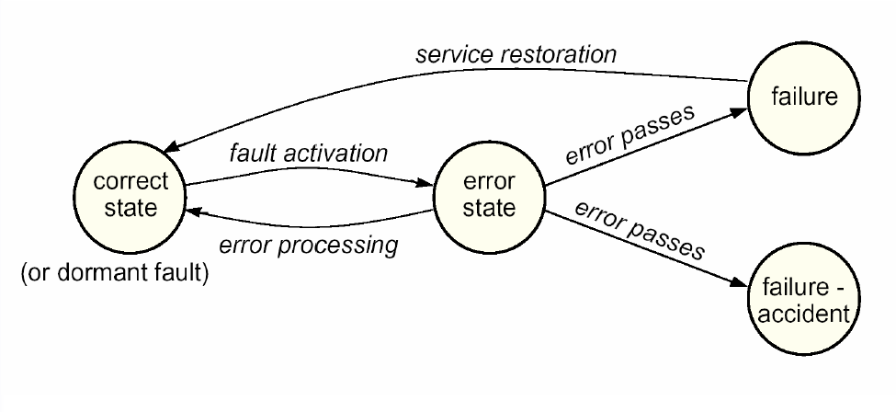
Fault/Failure state transitions

Slide 57
Fault Classification
Nature (Critical distinction):
􀂄 random/hardware faults
􀂄 logical/systematic/design faults
E.g., Degradation (wear-out) vs. design faults
Duration:
􀂄 permanent, transient, intermittent
Extent:
􀂄 localized, global

Slide 58
Nature: Degradation Faults
􀂄 The system used to work but now it does not
􀂄 Something broke for some reason:
􀂆 Infant mortality
􀂆 End of useful life—wear out
􀂆 Physical damage—vibration, humidity, temperature
Examples:
􀂄 Light bulb burns out
􀂄 Disk head crashes
􀂄 Power supply fails

Slide 59
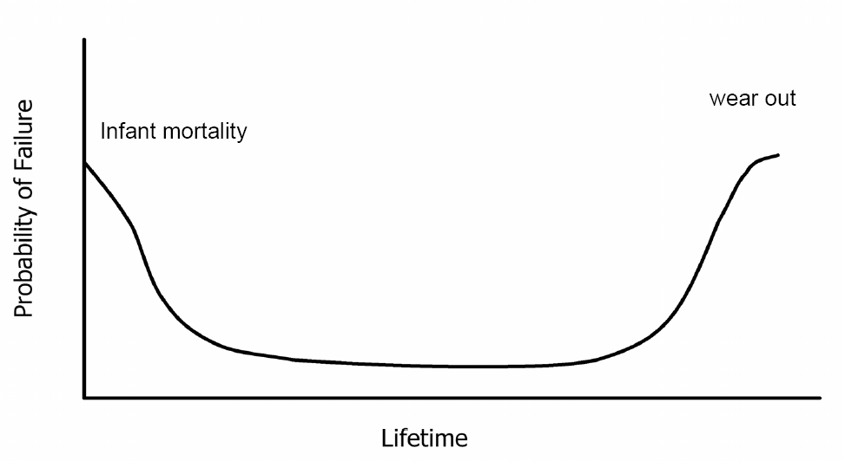
Nature: Failure “Bathtub Curve”

Slide 60
Nature: Design Faults
􀂄 The system never worked
􀂄 Nothing broke
􀂄 The design is flawed
Examples:
􀂄 Incorrect electrical wiring
􀂄 Software defect!

Slide 61
Dealing With Faults
Fault Prevention:
􀂄 Development techniques that prevent the introduction of faults
Fault Elimination:
􀂄 Development techniques that find and remove faults already introduce
Fault Forecasting:
􀂄 Estimate current number, future incidence and likely consequences
Fault Tolerance (not considered here):
􀂄 Execution-time techniques that cope with the effects of faults

Slide 62
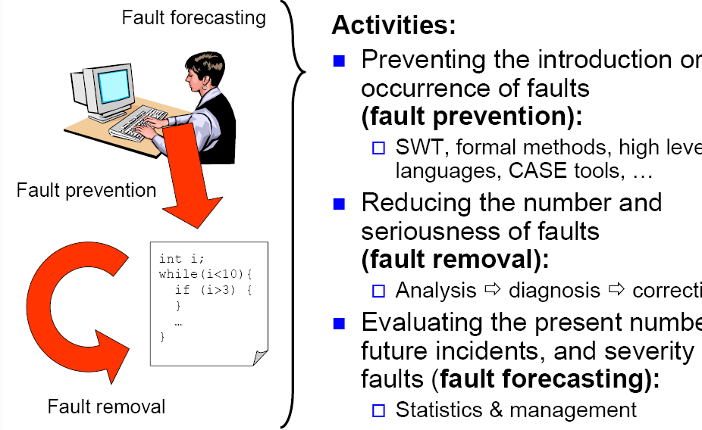
Fault Avoidance

Slide 63
Main causes for software faults:
1. Faulty requirements definition
2. Client-developer communication failures
3. Deliberate deviations from software requirements
4. Logical design errors
5. Coding errors
6. Non-compliance with documentation and coding instructions
7. Shortcomings of the testing process
8. User interface and procedure errors
9. Documentation errors

Slide 64
The Cost of Quality
􀂄 Cost of Quality includes all costs incurred in the pursuit of
quality or in performing quality related activities such as
appraisal costs, failure costs and external failure costs.
[Pressman2004]
The Quality Compromise:
􀂄 We cannot wait for specifications to improve before paying
attention to quality management.
􀂄 We must put quality management procedures into place to
improve quality in spite of imperfect specification

Slide 65
(1) Quality Assurance
Quality Assurance [ISO 9000]:
All those planned and systematic actions necessary to
provide adequate confidence that a product or service will
satisfy requirements for quality
Software quality assurance [IEEE]:
1. A planned and systematic pattern of all actions necessary to provide
adequate confidence that an item or product conforms to established
technical requirements.
2. A set of activities designed to evaluate the process by which the
products are developed or manufactured.
Contrast with: quality control.

Slide 66
Quality Assurance
Software quality assurance is :
A systematic, planned set of actions necessary to provide adequate confidence that the software development process or the maintenance process of a software system product conforms to established functional technical requirements as well as with the managerial requirements of keeping the schedule and operating within the budgetary confines.
􀂄 Quality assurance consists of the auditing and reporting
functions of management

Slide 67
(2) Quality Planning
􀂄 Quality planning is the process of assessing the
requirements of the procedure and of the product and
the context in which these must be observed.
􀂄 Quality assurance plan is the central aid for planning
and checking the quality assurance.

Slide 68
Quality Assurance Plan
􀂄 A quality assurance plan sets out the desired product qualities and
how these are assessed and defines the most significant quality
attributes.
􀂄 The quality assurance plan should define the quality assessment
process.
􀂄 It should set out which organizational standards should be applied
and, where necessary, define new standards to be used.

Slide 69
Quality Assurance Plans
􀂄 Quality assurance plan structure:
􀂆 Product introduction
􀂆 Product plans
􀂆 Process descriptions
􀂆 Quality goals
􀂆 Risks and risk management
􀂄 Quality assurance plans should be
􀂆 short,
􀂆 succinct
(If they are too long, no-one will read them)

Slide 70
Example: SQA Plan
Purpose of Plan
􀂄 References
􀂄 Management
􀂆 organization structure, SQA tasks,
their placement in the process
􀂆 roles and responsibilities related to
product quality
􀂄 Documentation
􀂆 project documents, models,
technical documents, user
documents.
􀂄 Standards, Practices and
Conventions
􀂄 Reviews and Audits
􀂄 Test
􀂆 test plan and procedure
􀂄 Problem Reporting and Corrective action
􀂄 Tools, Techniques
and Methodologies
􀂄 Code Control
􀂄 Media Control
􀂄 Supplier control
􀂄 Records Collection,
Maintenance and
Retention
􀂄 Training
􀂄 Risk Management

Slide 71
(3) Quality Control
Quality Control [ISO 9000]:
The operational techniques and activities that are used to fulfill requirements for quality
􀂄 Quality Control is the series of inspections, reviews and tests used throughout the development cycle to ensure that each work product meets the requirements placed upon it.

Slide 72
Quality Control
􀂄 This involves checking the software development process to ensure that procedures and standards are being
followed.
􀂄 There are two approaches to quality control
􀂆 Quality reviews;
􀂆 Automated software assessment and software
measurement.

Slide 73
Quality Control
Objective:
􀂄 minimize the produced defects
􀂄 increase the product quality
Implementation approaches:
􀂄 Fully automated
􀂄 Entirely manual
􀂄 Combination of automated tools and human interactions

Slide 74
Quality Control
Quality control includes a feedback loop to the process:
􀂄 provide management with the necessary data about product quality.
􀂄 gain the insight and confidence of product quality
Two types of quality control:
􀂄 Quality design: the characteristics that designers specify for an item
(includes: requirements, specifications, and the design of the system).
􀂄 Quality of conformance: the degree to which the design specification are followed. It focuses on implementation based on the design.

Slide 75
Quality Assurance System
􀂄 Quality assurance system is the organizational structure,
responsibilities, procedures, processes and resources for
implementing quality management.

Slide 76
Process and Product Quality
􀂄 The quality of a developed product is influenced by the quality of
the production process.
􀂄 This is important in software development as some product quality
attributes are hard to assess.
􀂄 However, there is a very complex and poorly understood
relationship between software processes and product quality.

Slide 77
Process-based Quality
􀂄 There is a straightforward link between process and product in
manufactured goods.
􀂄 More complex for software because:
􀂆 The application of individual skills and experience is particularly
important in software development;
􀂆 External factors such as the novelty of an application or the need
for an accelerated development schedule may impair product quality.
􀂄 Care must be taken not to impose inappropriate process standards these
could reduce rather than improve the product quality.

Slide 78
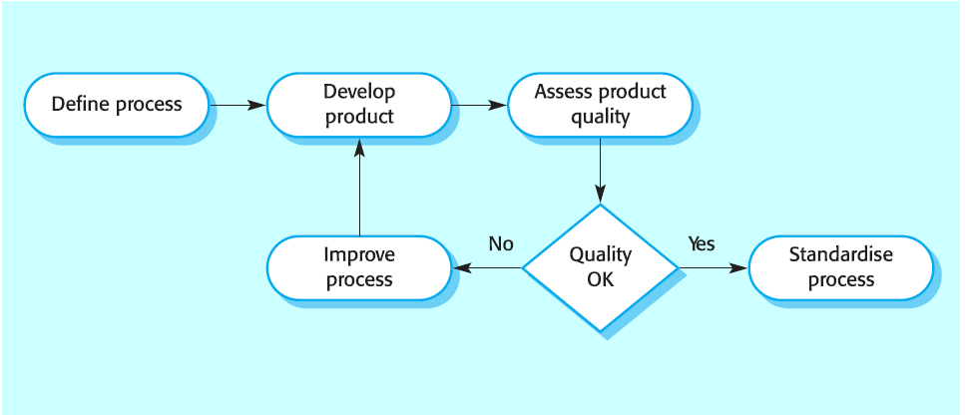
Process-based quality

Slide 79
Practical Process Quality
􀂄 Define process standards such as how reviews should be
conducted, configuration management, etc.
􀂄 Monitor the development process to ensure that standards
are being followed.
􀂄 Report on the process to project management and software
procurer.
􀂄 Don’t use inappropriate practices simply because standards
have been established.

